Slide 1
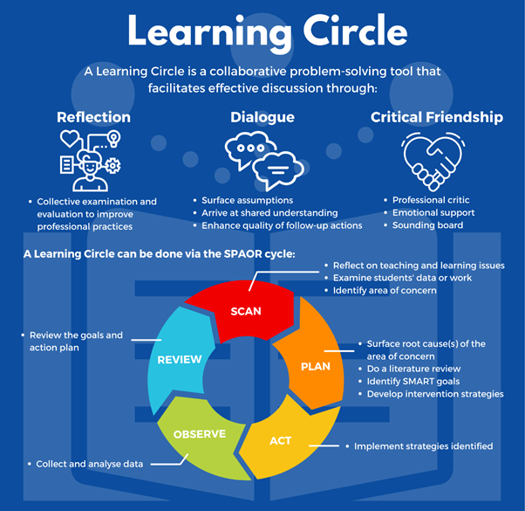

Slide 2


MLU: Introduction to Learning Circle (OPAL2.0)
● What is Learning Circle?
● What are the Steps in Learning Circle?
● Considerations and Misconceptions

Slide 3
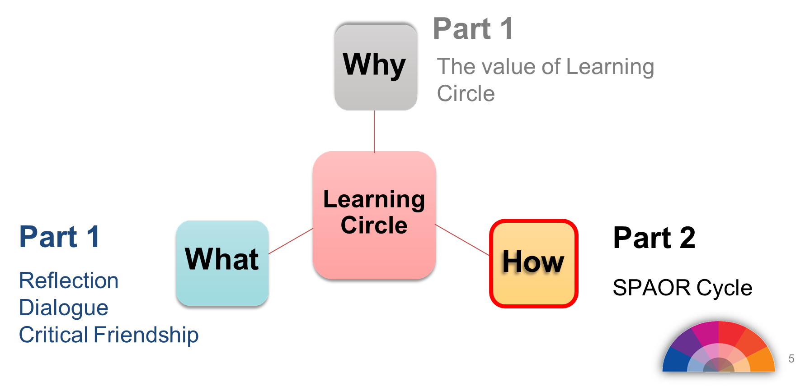

Slide 4
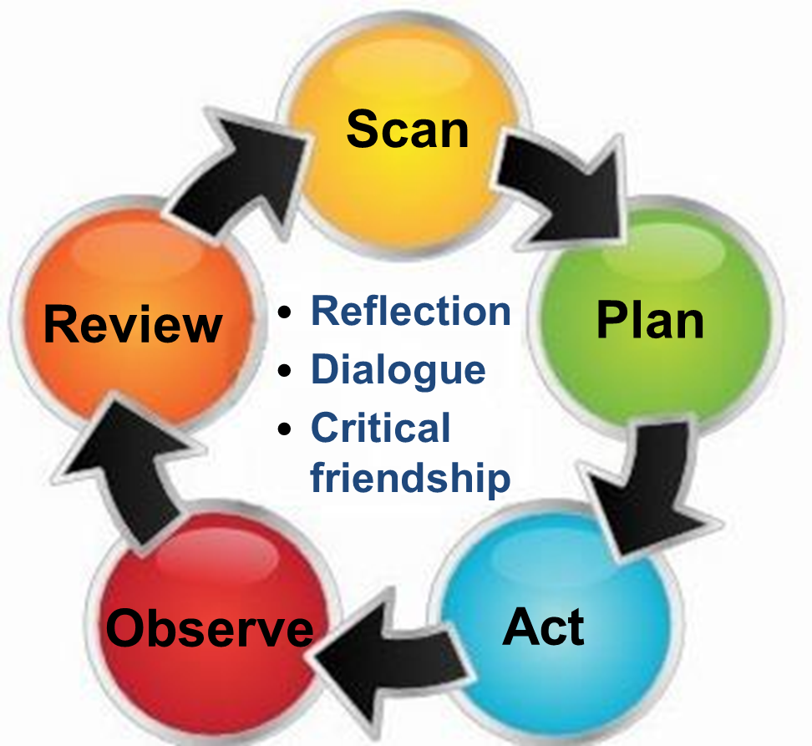
SPAOR Cycle

Slide 5

Scan
Conduct reflections on teaching and learning issues.
Examine children’s data or work Identify an area of concern or problem.

Slide 6
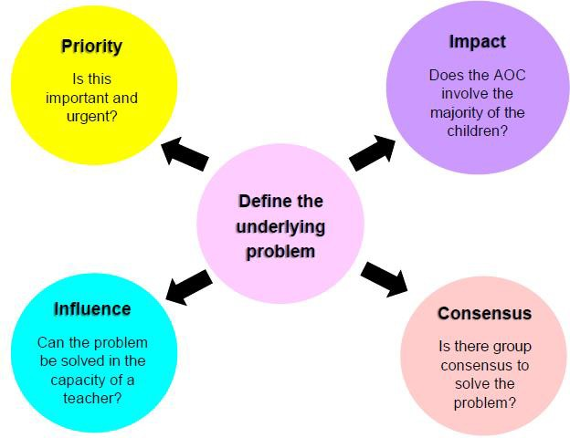
Key Considerations of AOC

Slide 7
Area of Concern
The area of concern (AOC) provides the background and nature of the problem. It is expressed as a paragraph of statements, and should cover the following aspects:
Problem area
How the problem is manifested
Current actions

Slide 8
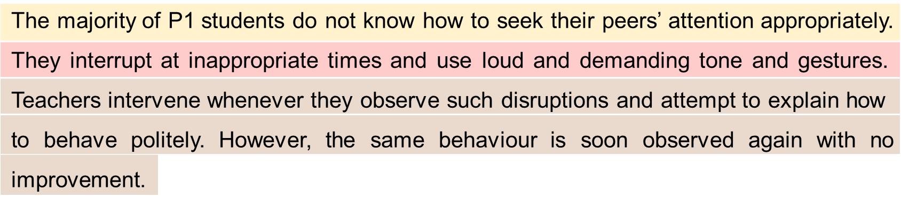
Area of Concern
Can you identify the 3 aspects of an AOC?
Problem area
How the problem is manifested
Current actions

Slide 9

Plan
Surface root cause(s) based on your scan.
Conduct a literature review
Develop intervention strategies
Write your research question

Slide 10
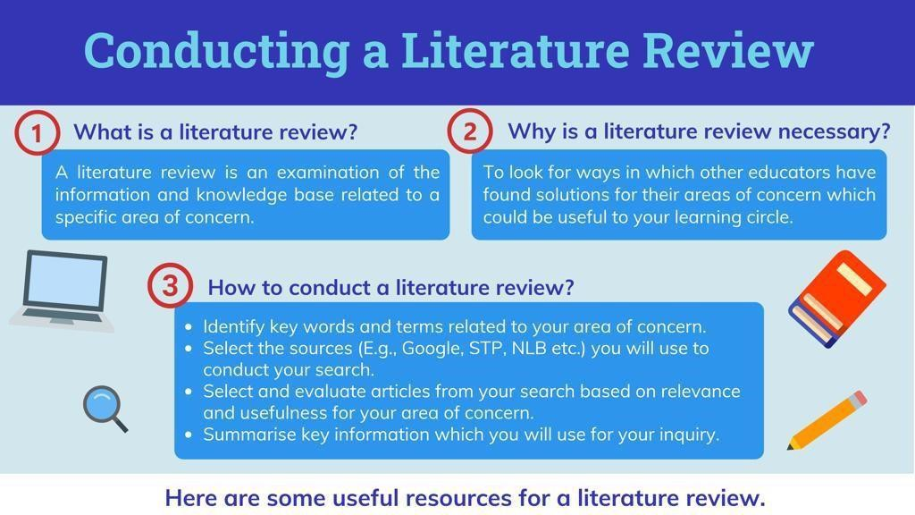






Slide 11

Plan
Surface root cause(s) based on your scan.
Conduct a literature review
Develop intervention strategies
Write your research question

Slide 12

Plan
Surface root cause(s) based on your scan.
Conduct a literature review
Develop intervention strategies
Write your research question

Slide 13
Write a Research Question
A research question (RQ)
reframes the problem into a question
and includes the goal and strategy to address the problem.
The RQ is derived from the area of concern (AOC).

Slide 14

Crafting a Research Question
AOC
The majority of P1 students do not know how to seek their peers' attention appropriately. They interrupt at inappropriate times and use loud demanding tone and gestures. Teachers intervene whenever they observe
such disruptions and attempt to explain how to behave politely. However, the same behaviour is soon observed again with no improvement.
A possible RQ:
To what extent does incorporating social stories (strategy) in lessons improve the P1 children’s ability to interact effectively and appropriately with their peers (goal)?
24

Slide 15



The Importance of a Good Research Question
A good research question helps the team to define what exactly what they are trying to find out, and influence the steps taken to conduct the research.
Are there any other strategies that are used in lesson during the research, and would influence/affect the results?
RQ: To what extent does incorporating social stories in lessons improve the
K2 children’s ability to interact effectively and appropriately with their peers?
Should the strategies be applied to a wider group e.g. lower primary children? Any prerequisites for the group?
What are the indicators to show that the interaction is effective and appropriate?
Number of conflicts? Use of polite phrases?

Slide 16
Crafting a Research Question
Format to consider — P.E.O
Population/ People/ Problem | e.g. P1 students
Exposure | e.g. social stories
Outcome | e.g. interact effectively and appropriately with ^{their peers}

Slide 17

Crafting a Research Question
Considerations when writing a good RQ:
Focused on a single topic or several closely related ideas | Researchable using primary and/or secondary source
Specific | Not asking for opinions
Allows complex answers and cannot be answered with “yes” or “no” or a single word or phase | Feasible to answer within the timeframe and practical constraint
How can we improve on the following RQ?
Does pretend play, or outdoor pretend play, help children learn better?
Notes:
Avoid subjective words like good, bad, better and worse. These do not give clear criteria for answering the question.
Is X or Y a better policy?
How effective are X and Y policies at reducing rates of Z?
Closed-ended, yes/no questions are too simple to work as good research questions—they don’t provide enough scope for robust investigation and discussion.
Make sure you have enough time and resources to do all research required to answer your question.
Primary sources provide raw information and first-hand evidence. Examples include interview transcripts
Secondary sources provide second-hand information and commentary from other researchers. Examples include journal articles, reviews

Slide 18
Crafting a Research Question
How can we improve on the following RQ?
Does pretend play, or outdoor pretend play, help students learn better?
Not focused — Are we looking at pretend play, outdoor pretend play or indoor pretend play?
Not specific — how do we know if the students are ‘learning better’? Is there a specific aspect we are looking at e.g. motor skills, language development or social skills?
Allows only yes/no answer, or for opinion
Feasibility — is it practical and feasible to look at both outdoor and indoor pretend play? Do we have data with similar indicators for indoor pretend play?
Suggested RQ:
To what extent does pretend play(E) develop P1 students'(P) problem solving skills(O)?

Slide 19






Act
Implement the strategies identified in the action plan to address the AOC
Scan
• Reflection
• Dialogue
• Critical friendship
Example: Intervention Strategies Use of social stories to teach children how to get attention from peers politely.
Plan
Act

Slide 20














Observe
Data collection include both qualitative and quantitative methods.
Examination
of Artefacts
Questionnaires
Observations
Interviews
QUANTITATIVE
QUALITATIVE
MIXED METHODS
LC members can use existing data from classroom teaching and learning
activities such as students’ work, lesson artefacts and lesson observations.
Mixed Methods Approach: Quantitative data (number of conflicts related to peer interruptions) + Qualitative data (interview)
35

Slide 21



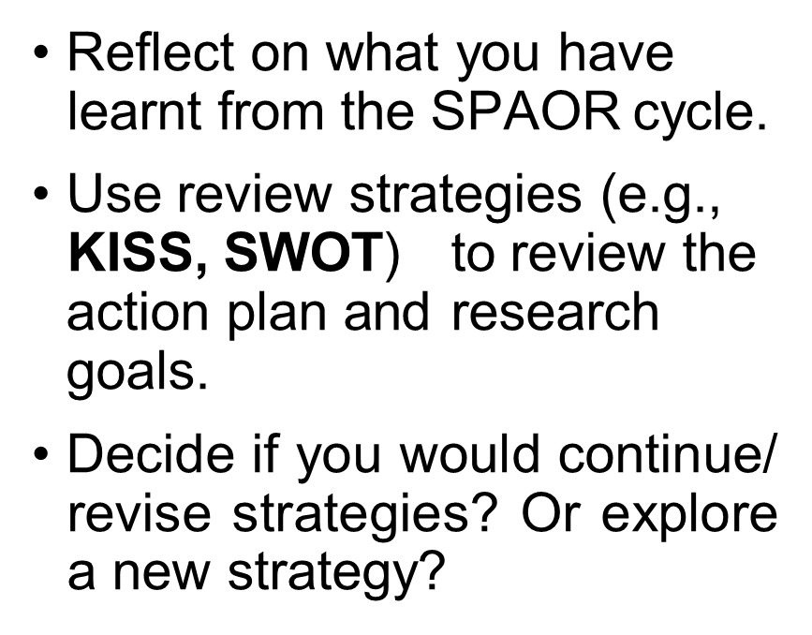
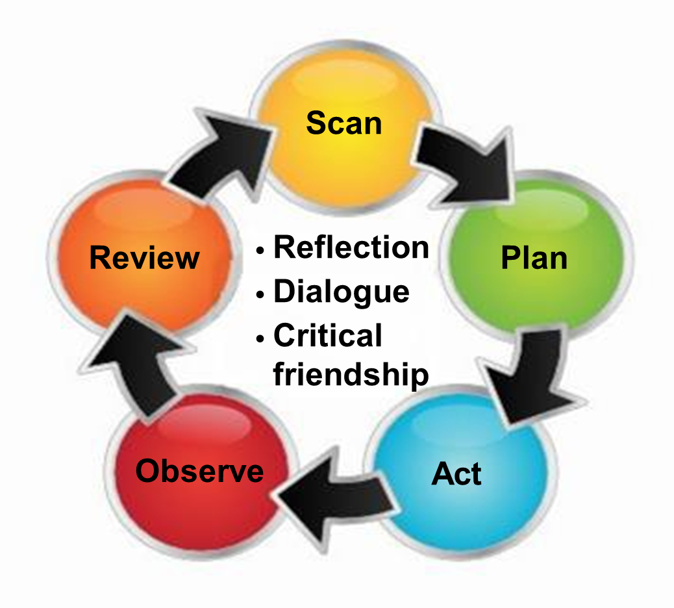
Review

Slide 22
K-I-S-S
Keep
What areas are working well and should continue to keep?
Use of social stories
Explicit teaching of conflict resolution strategies and polite
phrases
Improve
What are the areas for improvement?
Create more social stories
Increase the frequency of sharing social
stories
Use swivl to record lessons
Start
What are the new strategies worth starting?
Get students to co-create new social stories
Stop
What areas are ineffective and need to stop?
Manual logging of conflicts during lessons

Slide 23
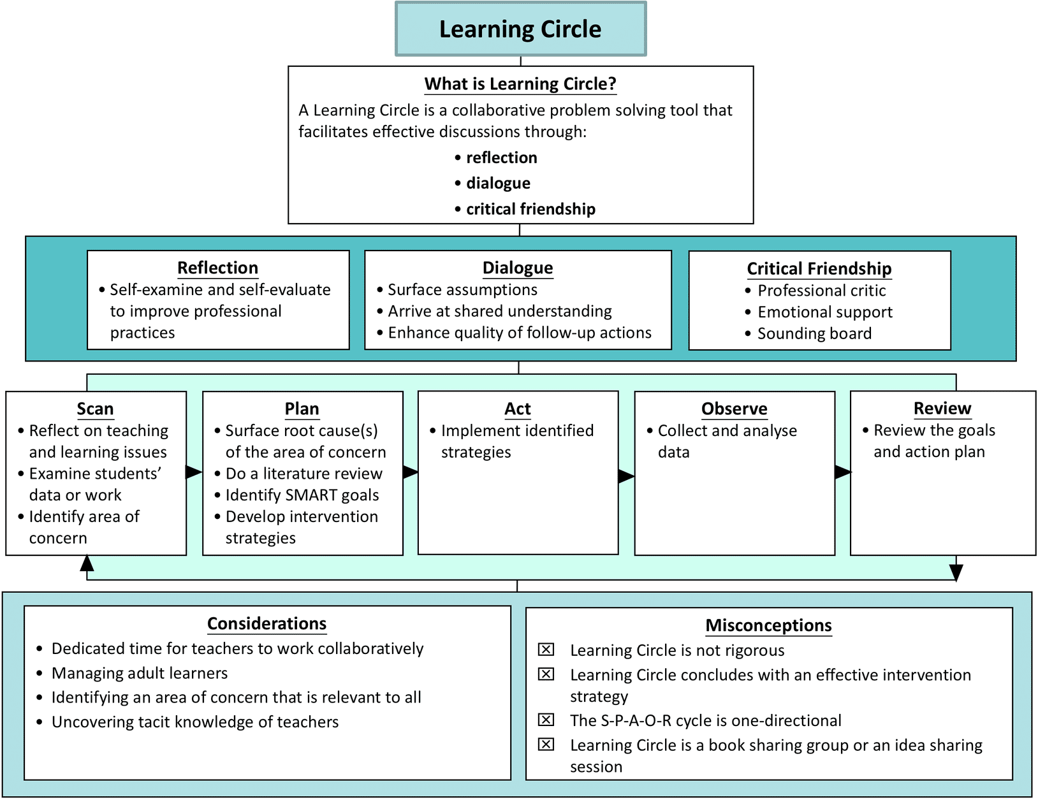

Slide 24
PLT Deliverable: Poster or any form of visual representation
Suggested Outline
Title: [Lesson Topic]
Inquiry & Lesson Focus / AOC & RQ
Briefly state your main inquiry question / AOC & RQ
Provide a short description of the lesson focus / AOC & RQ
Key Findings
List 3–4 bullet points that summarise the most important observations or outcomes from the lesson study / SPAOR Cycle
Highlight student learning outcomes
Reflections & Next Steps
Summarise one or two key reflections
List any recommended next steps or adjustments for future lessons

Slide 25

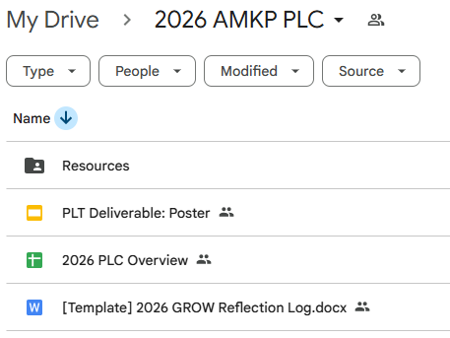
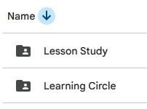
PLC Folder
go.gov.sg/amkp2026plc

Slide 26
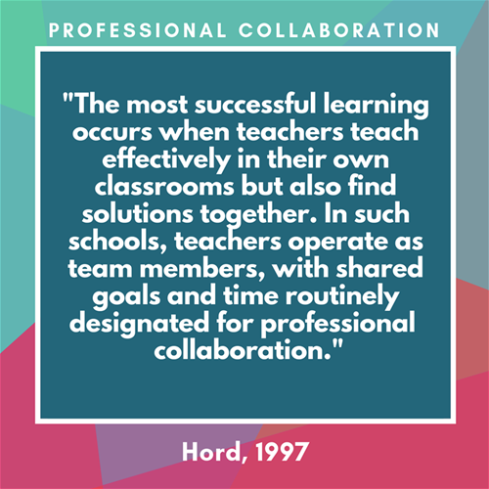
Notes:
This quote highlights the essence of PLC which is a process to foster a culture of professional excellence where we learn and find solutions together to improve pupil outcomes in a systematic and timely and also to enhance own professional learning.

